Slide 1

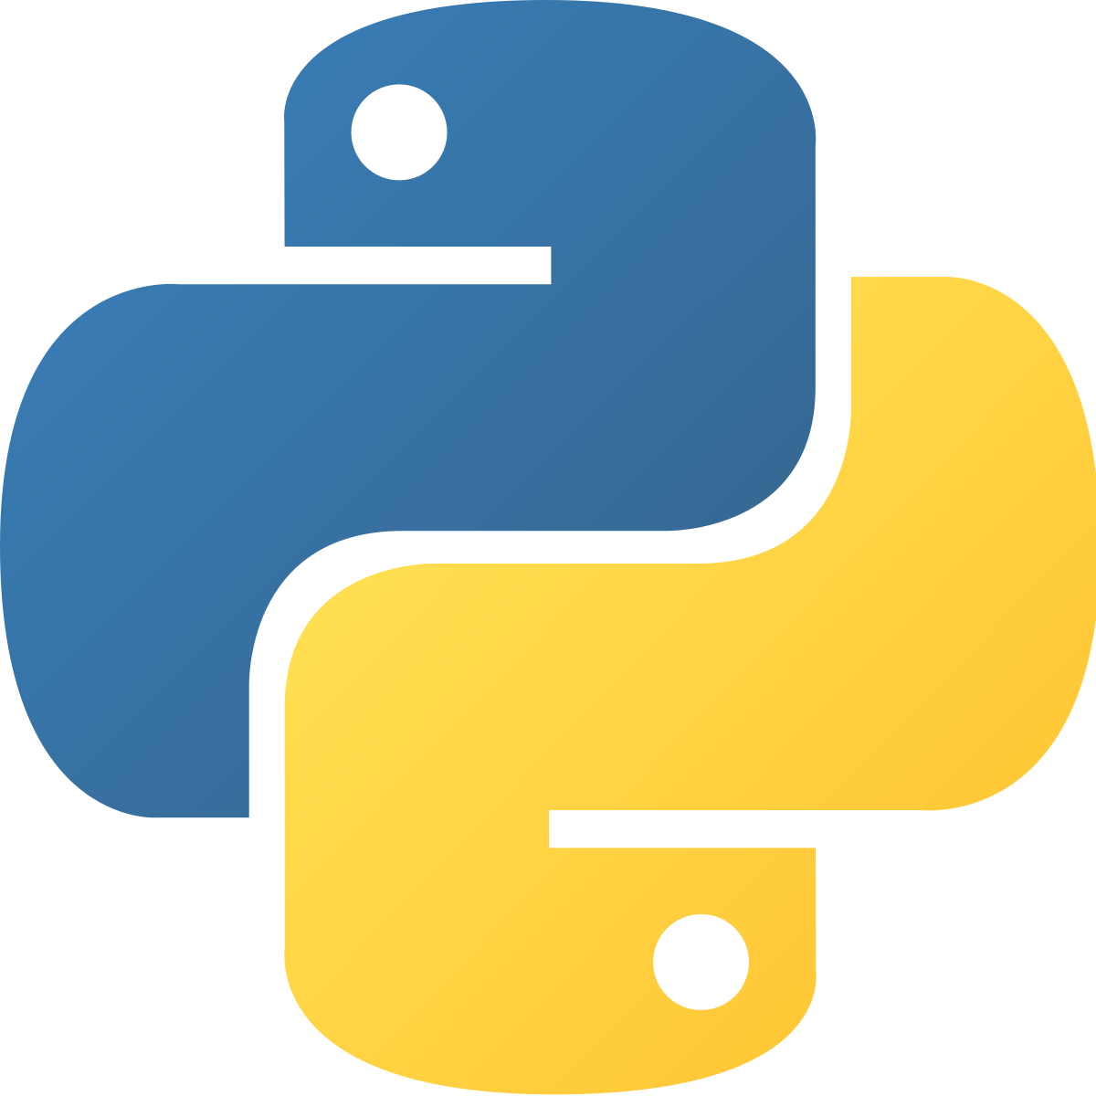
Python Programmer

Slide 2
Contents
1. GETTING STARTED
1.1 History and need of python
1.2 Applications of python
1.3 Advantages of python
1.4 Disadvantages of python
1.5 Installing python
1.6 program structure
1.7 Interactive Shell
1.8 Executable or script files
1.9 User Interface or IDE

Slide 3
History of Python
Python laid its foundation in the late 1980s.
The implementation of Python was started in December 1989 by Guido Van Rossum at CWI in Netherland.
In February 1991, Guido Van Rossum published the code (labelled version 0.9.0) to alt.sources.

Slide 4
History
In 1994, Python 1.0 was released with new features like lambda, map, filter, and reduce.
Python 2.0 added new features such as list comprehensions, garbage collection systems.
On December 3, 2008, Python 3.0 (also called "Py3K") was released.

Slide 5
Application
The applications are:
i. Web and internet development
ii. Games
iii Language development
iv. Operating system
v. Image processing and graphic design application
vi. Scientific and computational applications
vii. Business application development

Slide 6
Advantages
1) Readable and Maintainable Code
  Python, unlike other programming languages, emphasizes on code readability, and allows you to use English keywords instead of punctuations.
  The readable and clean code base will help you to maintain and update the software without putting extra time and effort.
2) Multiple Programming Paradigms
  It supports object oriented and structured programming fully.
  At the same time, Python also features a dynamic type system and automatic memory management.
  The programming paradigms and language features help you to use Python for developing large and complex software applications.

Slide 7
Disadvantages
Speed
  Python is slower than C or C++. But of course, Python is a high-level language, unlike C or C++
  it's not closer to hardware.
Mobile Development
  Python is not a very good language for mobile development . It is seen as a weak language for mobile computing. This is the reason very few mobile applications are built in it like Carbonnelle.
Memory Consumption
Python is not a good choice for memory intensive tasks. Due to the flexibility of the data-types, Python's memory consumption is also high.

Slide 8
Thank you

Slide 9
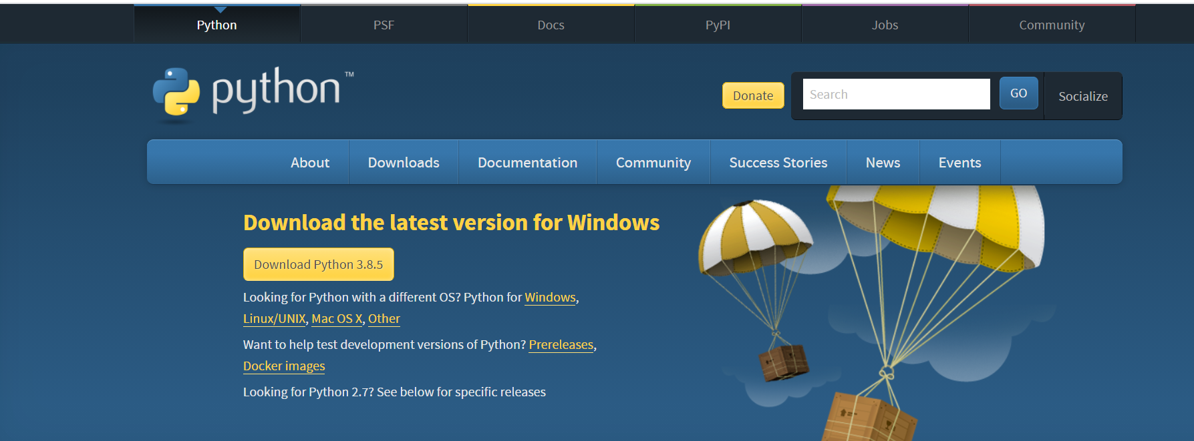
Installing Python
Link - https://www.python.org/downloads/

Slide 10
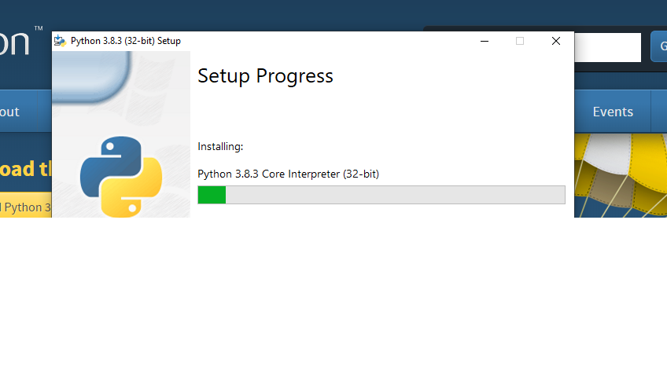
Double click on exe file

Slide 11
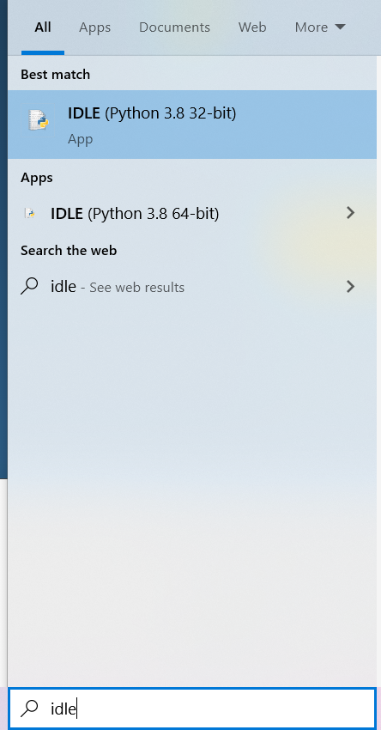
Search in Start - IDLE

Slide 12
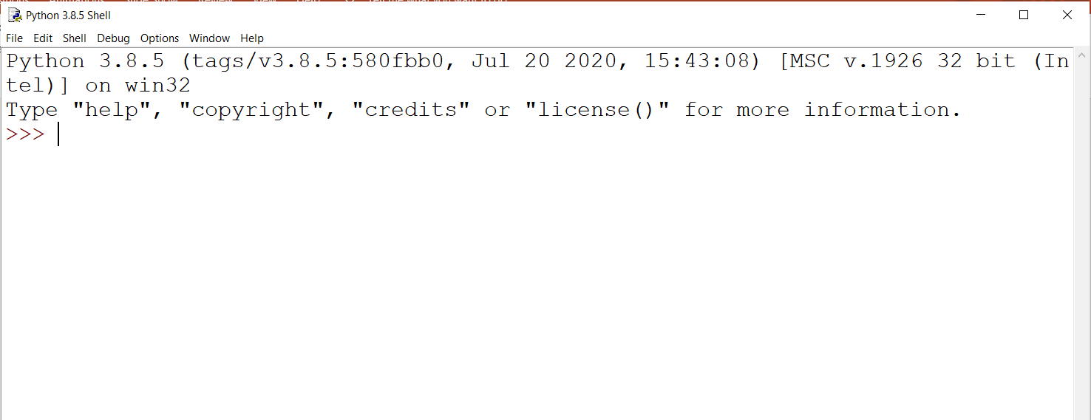
Open the IDLE python

Slide 13
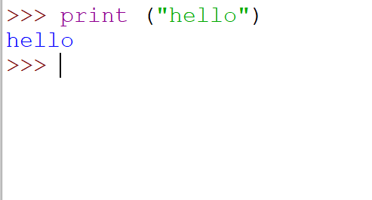
Can give the command – Interactive mode

Slide 14
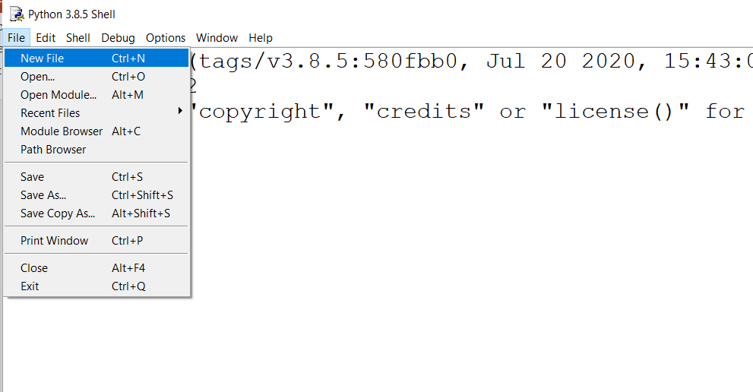
Scripting Mode

Slide 15
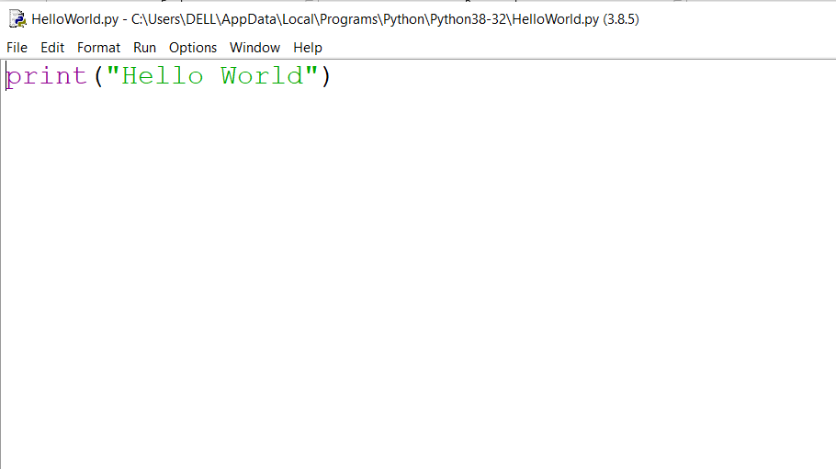
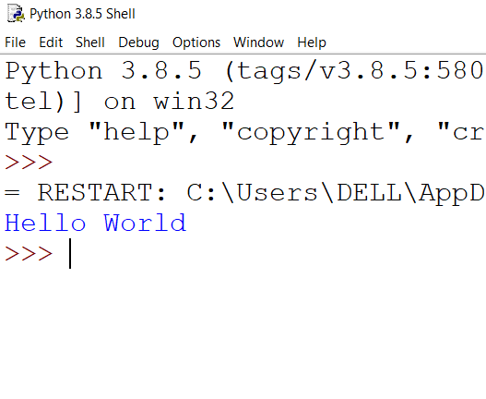
Print a Message in python

Slide 16
Structure of Python
It is known to all that the interpreter always reads and executes the given projects’ statements line by line or sequentially.
But, some of the statements can be used to change the project behavior, such as conditional statements.
The Python projects’ statements are usually written in a specified format in which a single statement needs to write within a single line.

Slide 17
You can write multiple statement in same line.
In the Python programs, you can use indentation. Whitespace used in the indentation before the particular statement has a significant role as it offers different meanings.

Slide 18
UserInterface or IDE
IDE stands for Integrated Development Environment. It’s a coding tool which allows you to write, test, and debug your code in an easier way, as they typically offer code completion or code insight by highlighting, resource management, debugging tools,… And even though the IDE is a strictly defined concept, it’s starting to be redefined as other tools such as notebooks start gaining more and more features that traditionally belong to IDEs.
popular IDE
Visual studio code
pycharm
Jupiter etc...

